Slide 1
WEB PROGRAMMING
MCNDHS
Ms.Eng

Slide 2
AIM: HOW DOES THE INTERNET WORK?
Do Now:
From the three articles, please find the the:
TITLE
BODY

Slide 3
WHAT IS THE INTERNET?
Easy definition: A system of connected computer devices.
INTERNET
interconnected
Network

Slide 4

CONCEPT (IDEA)
Simply a network of computers connected together.

Slide 5
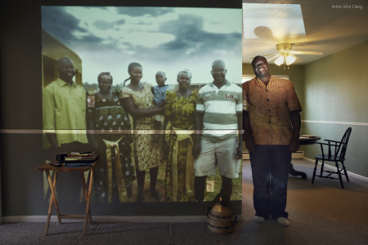
THIS MEANS
You can be connected from one part of the world to another

Slide 6
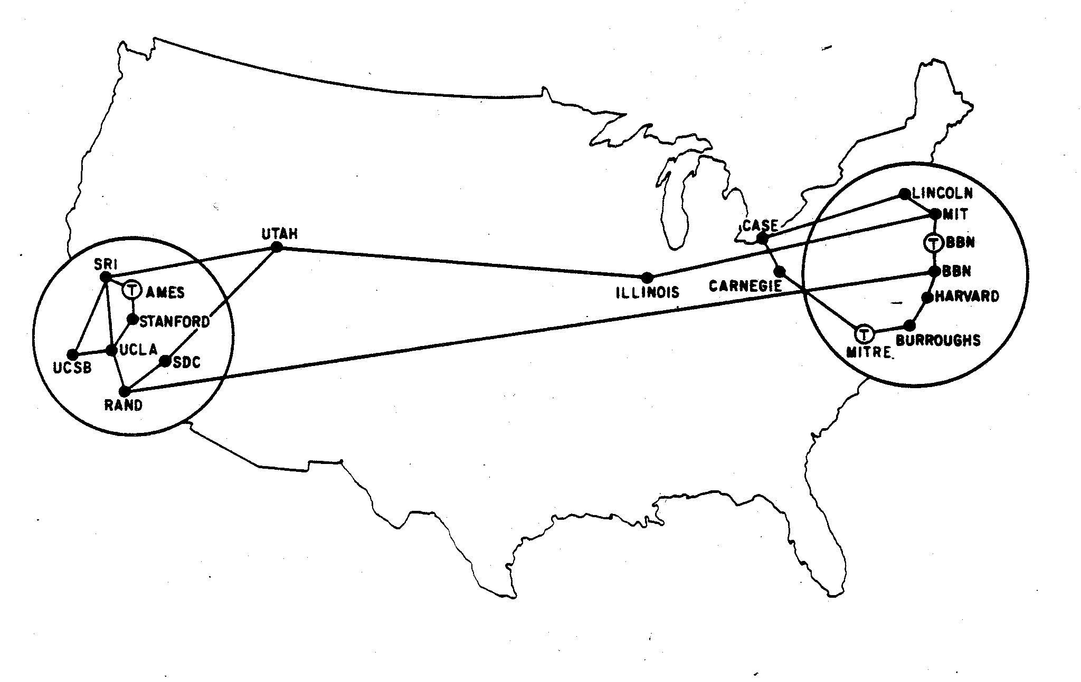
ARPANET
ARPA NET (PRIVATE, for military, and research)

Slide 7
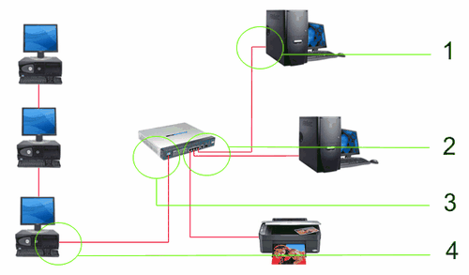
ETHERNET
Ethernet (Private: personal, and business)

Slide 8

INTERNET
Internet: (public)

Slide 9
WHERE DID THE WWW COME FROM?
The World Wide Web (WWW) was created in 1990 by CERN on 30 April 1993, CERN announced that the World Wide Web would be free to use for anyone.
CERN: The European Organization for Nuclear Research

Slide 10
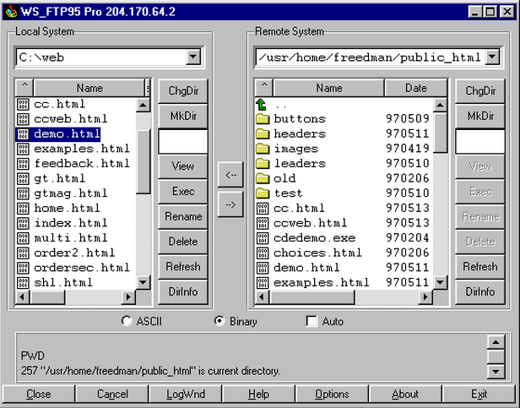
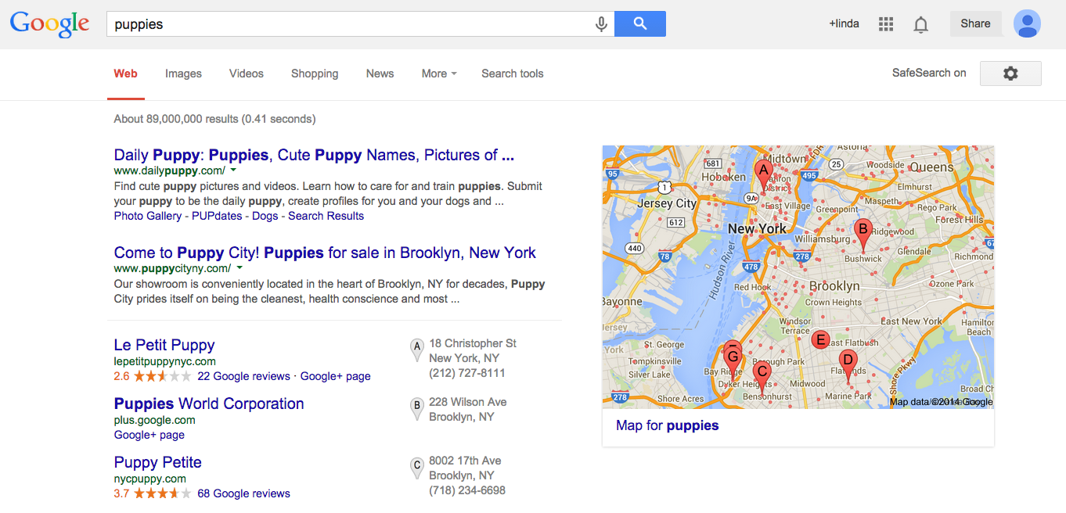
HOW THE INTERNET WORKED
Before HTML (language for building websites), there was FTP (File Transfer Protocol).
HTML (websites) FTP(File sharing)

Slide 11
HOW DOES THIS HAPPEN?
Three checkmarks:
1)Rules for packaging data.
2) An interconnected network to send the data through.
3) A route (roadmap) for the data to travel to.

Slide 12
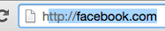
STEP-BY-STEP
All data transfers follows a rule.
This rule is called HTTP
(Hypertext Transfer Protocol)

Slide 13
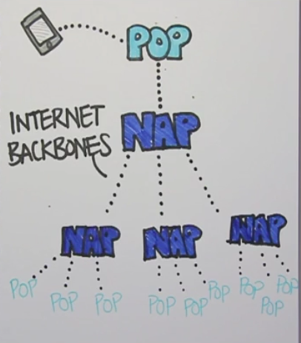
phone/computer
Point of presence
Network access point
Connect to other nap
Connect to other pop

Slide 14
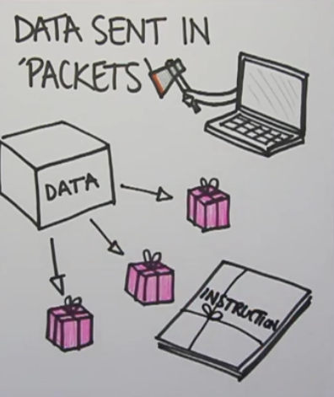
HOW IS DATA PACKAGED?
Data is sent in “Packets”
Along with instruction
manual on how to put the
data back together

Slide 15

THINK OF IT LIKE THIS:
Packets are like puzzle pieces.
When sending packets you need two things:
Address (Where are you sending it to?) IP address
2. Instructions on how to put the packets together.

Slide 16
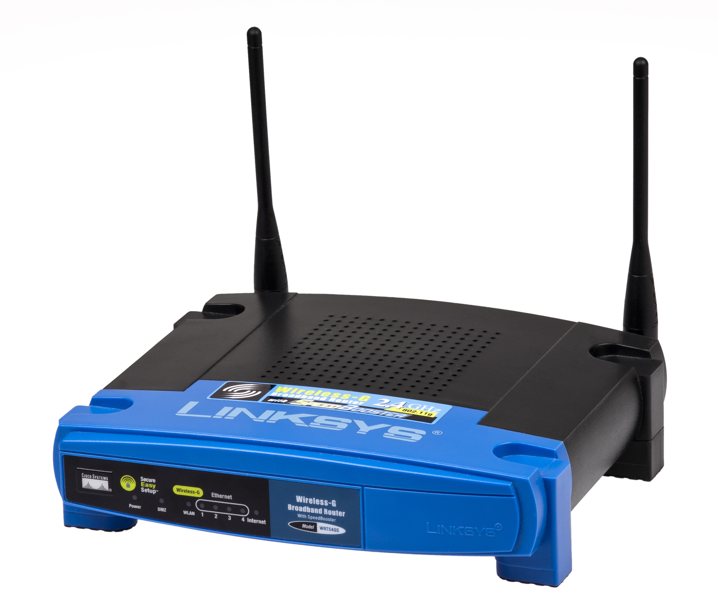
HOW DOES YOUR DATA KNOW WHERE IT IS GOING?
By using routers.
Routers make sure your packets go to their right destinations through the internet backbone.

Slide 17
WHAT TAKES PRIORITY?
1)Structural framework
2)text
3)search bar (navigational bar)
4)images
5)videos

Slide 18
YOU TRY! (ACTIVITY)
Pick out two webpages and try to document the order the items load.
Ask yourself, why do those items load in that particular order?

